Slide 1
Basic IoT based Home Automation

Slide 2
What is IoT?
The Internet of Things (IoT) is the network of physical objects or "things" embedded with electronics, software, sensors, and network connectivity, which enables these objects to collect and exchange data.
A “Thing” in the context of the Internet of things (IoT), is an entity or physical object that has a Unique identifier, an embedded system and the ability to transferdataovera network.
Heart monitoring implants ,Biochip transponderson farm animals, Automobileswith built-in sensors , DNA analysis devices & OtherWearbles etc.
These devices collect useful data with the help of various existing technologies and then autonomously flow thedata between otherdevices.

Slide 3
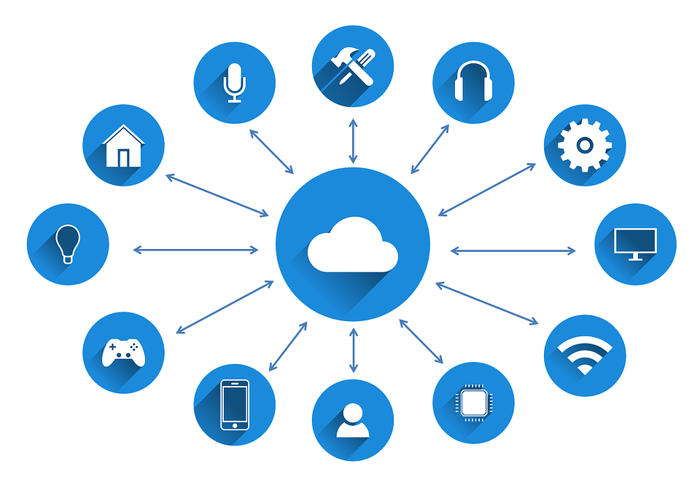
Subtopics
MQTT
Big-Data
M-2-M

Slide 4
MQTT
Message Queuing Telemetry Transport
It is use to communicate beytween devices which are connected through the Internet
MQTT contain 4 basic things:
1. Publisher/Subscriber
2. Message
3. Topics
4. Broker

Slide 5
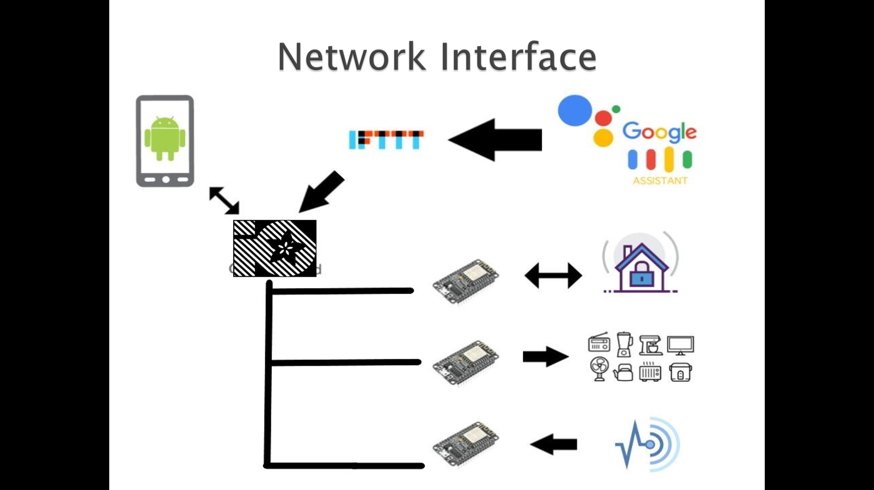
Network Interface:

